Slide 1





1
4
LOU WOODYARD
“Behind every good business is a great accountant.”
Age: Late 40s
Motivations
Business
health
Business
growth
BIO
While studying Lou worked in a cafe and then as a book keeper in a small business.
3
5
COMPANY ACCOUNTANT
^{· PERSONALITY TYPE}
^{AFFILIATIVE}
^{· REPORTS TO}
^{CEO}
^{· STAFF: 3}
^{· INCOME}
^{$180K}
^{· EDUCATION}
^{Batchelor of}
^{Accounting}
Performance
Measures
TIMELY REPORTS
ACCURATE REPORTS
ZERO TAX PROBLEMS
IMPROVED PROCESSES
SUCCESSFUL TRUCKIN BITS INTEGRATION
2
ROLE & RESPONSIBILITIES
6
30%
Supervision
40%
Improving systems
10%
Assets register
20%
Meetings
7
8
9
Goals
Frustrations
INFLUENCES
COMPETITORS
RAY DALIO (BUSINESS AUTHOR),
NAOMI SIMSON (ENTREPRENEUR)
Smooth acquisition of Truckin Bits.
Smooth implementation of ERP.
Train staff to use ERP.
Train staff to use now business systems.
Outdates systems and software.
Incompatible systems
Understaffed.
Narrow skillsets of staff.
10
FREQUENTLY USED APPS
MS Office 365
Monday
Quicken
Unknown ERP

Slide 2
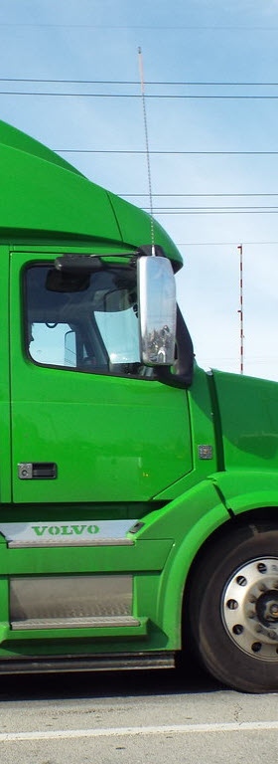
1
4
TRUCKIN STUFF
“Locally made and on the move.”
16 years old
BIO
Truckin Stuff is a family business that has grown. We’re meeting a need for locally made truck parts.
Motivations
Growth
Ideology
Teamwork
Quality
Truck parts
3
5
^{· EMPLOYEES: 250}
^{· INCOME: $68M}
2
9
Performance
Measures
> 15% Annual Growth
TEAMWORK
raving customers
EMPLOYEE BENEFITS
20 DAYS ANNUAL LEAVE
PUBLIC HOLIDAYS
10 DAYS SICK LEAVE
PENSION FUND
FLEXIBLE HOURS
WORK AT HOME
OR OFFICE
7
8
6
Goals
Frustrations
CLIENTS
Transport companies (B2B).
Frustrations:
  Long wait times for original parts.
  Expense of original parts.
  Big brands don’t support old models
Geography - National.
Compliance.
Unreliable suppliers.
Too many debtors.
Not strategic enough.
Old equipment
Narrow skillset of staff
Systems to capture client feedback.
Customer Relationship Management system
Improved information systems.
Improved post sales support
Staff integration from two businesses.
Acquire more suppliers
FREQUENTLY USED APPS
10
MS Office 365
Monday
Quicken
Unknown ERP

