Slide 1




1
4
LOU WOODYARD
“I love being part of a QSR success story.”
Age: Mid 30s
Motivations
Profit
Teamwork
Ideology
BIO
Lou grew up in a family run Quick Service Restaurant (QSR) and loves the idea of being part of ABC-Co’s success story.
Lou reads marketing news from sites like Forbes and SmartCompany.
3
5
DIGITAL MARKETING MANAGER
^{· PERSONALITY TYPE}
^{AFFILIATIVE}
^{· REPORTS TO}
^{CEO}
^{· STAFF: 5}
^{· INCOME}
^{$100K}
^{· EDUCATION}
^{Batchelor of}
^{Digital Marketing}
Performance
Measures
# satisfied clients
# improved services
# improved processes
Workplace morale
Business growth
ROLE & RESPONSIBILITIES
2
6
10%
Overseeing
implementations
15%
Writing
Specifications
10%
Monitoring
15%
Meetings
10%
Geography
40%
ROI
7
8
9
Goals
Frustrations
INFLUENCES
COMPETITORS
COLLEAGUES
INDUSTRY BLOGS
INFLUENCERS LIKE…
– GARY VAYNERCHUCK
– SETH GODIN
– JEFF WALKER
Ordering app to improve
customer experience.
New restaurants, food trucks.
Focus on strategy
rather than
day-to-day issues
Streamline production operations.
Tame business data.
Too much time spent on micro-management.
Systems & processes too complicated.
Masses of data, but no tools to manage and easily summarize it.
Overworked. Not enough time to learn and implement new systems.
Limited IT support.
Narrow skillsets of staff.
FREQUENTLY USED APPS
10
MS Office 365
Hootsuite
Mailchimp

Slide 2
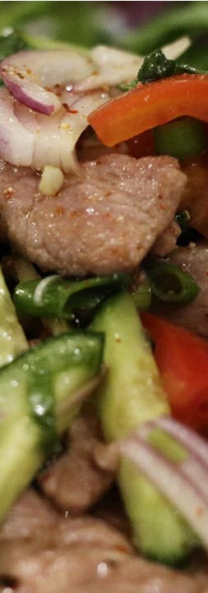


1
4
ABC-Co
“Growth on the back of fast, fresh and flavorsome.”
5 years old
BIO
ABC-co is a fast growing Thai street food QSR. Three years ago we were 4 restaurants, now we’re 11, and next year we’ll be 21. On the back of our obsession with sharing our style of street food with the world, we’re building a reputation for fast, fresh and flavorsome.
Motivations
Profit
Ideology
Teamwork
Quality
Thai Quick Service Restaurant
3
5
^{· EMPLOYEES: 235}
^{· INCOME: $35M}
2
9
Performance
Measures
> 15% Annual Growth
raving customers
EMPLOYEE BENEFITS
20 DAYS ANNUAL LEAVE
PUBLIC HOLIDAYS
10 DAYS SICK LEAVE
PENSION FUND
FLEXIBLE HOURS
WORK AT HOME
OR OFFICE
7
8
6
Goals
Frustrations
CLIENTS
Business-to-customer (B2C).
Mid 20s-mid30s time poor.
Frustrations:
  Delay from order to delivery too long
  Not enough outlets.
Eastern metro focus.
Recruiting is time consuming and
EXTRA work.
Too much time wasted reorganizing shifts.
Lack of alignment when working with
multiple teams.
Too much time spent on managing projects.
Masses of data, but no tools to manage.
and easily summarize it.
Zero training in new systems.
Lack of productivity
Limited IT support
Narrow skillset of staff
New project management systems.
New office systems.
New customer engagement systems.
New supply chain systems
FREQUENTLY USED APPS
10
Monday CRM
MS Office 365
Xero Accounting
Mailchimp

